Slide 1
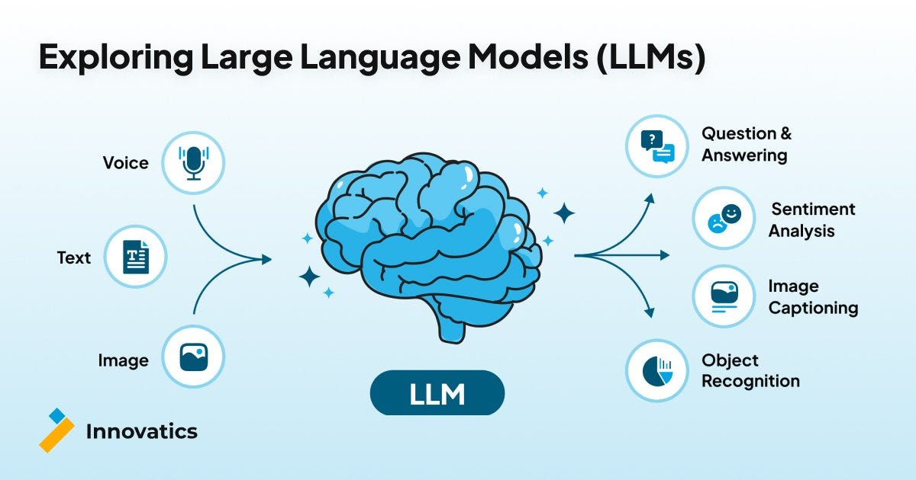

AI Basics: Understanding Large Language Models
A Comprehensive Guide to Tokens, Context Windows, and Pricing

Slide 2



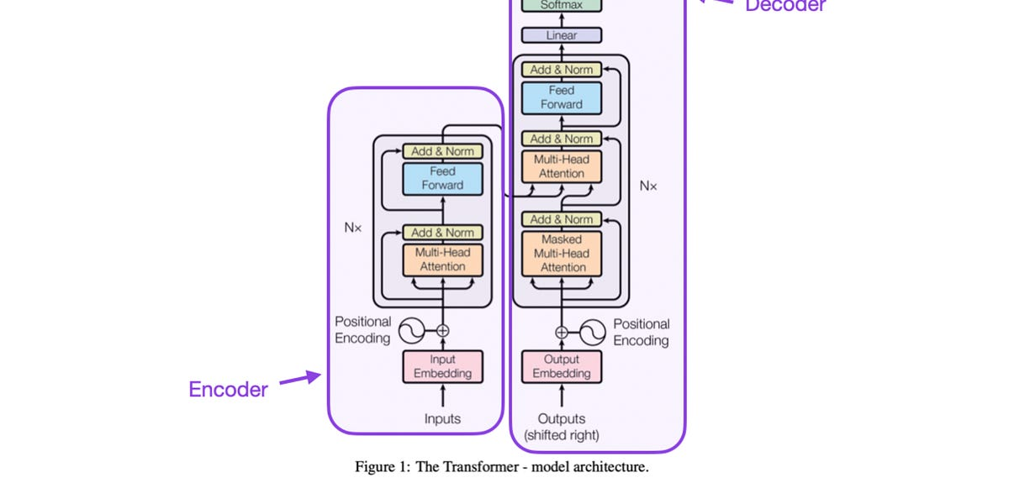
Introduction to LLMs
What are LLMs?
Key Players
Neural networks trained on vast text data
OpenAI: GPT series
Capable of understanding and generating human-like text
Anthropic: Claude series
Based on Transformer architecture (2017)
Google: Gemini series
Meta: Llama series
Evolution
Mistral: Mistral models
2018: GPT-1 (117M parameters)
DeepSeek: DeepSeek models
2020: GPT-3 (175B parameters)
2023: GPT-4 (1.76T parameters)
2025: GPT-5 and other frontier models

Slide 3

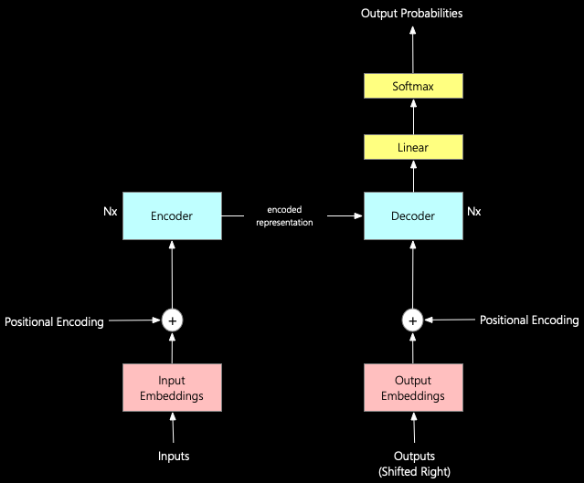


LLM Architecture
Transformer Architecture
Introduced in 2017 by Google
Replaces RNNs and CNNs for NLP
Parallel processing of all tokens
Positional encoding for sequence order
Attention Mechanisms
Self-attention: Each token attends to all others
Multi-head attention: Multiple attention layers
Weighted sum of all token representations
Enables understanding of context and relationships
Key Components
Embedding layer: Converts tokens to vectors
Positional encoding: Adds position information
The Transformer architecture with encoder-decoder structure and multi-head attention mechanisms
Feed-forward networks: Non-linear transformations
Layer normalization: Stabilizes training

Slide 4

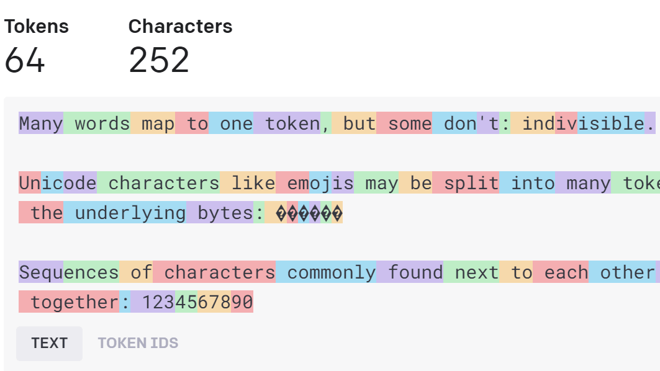


Tokens Explained
What are Tokens?
Smallest units of data processed by AI models
Not always whole words - can be parts of words
For English: 1 token ≈ 4 characters or 0.75 words
Each token has a numerical representation
Tokenization Process
Text is broken down into smaller pieces
Common methods: Byte-Pair Encoding, WordPiece
Optimized to reduce vocabulary size
Example of how text is broken down into tokens for processing by AI models
Helps models handle unknown words and languages
Why Tokens Matter
Foundation of model training and inference
Example: Tokenization
Determines context window capacity
"Understanding AI models" becomes: Under[1] standing[2] AI[3] models[4]
Directly impacts pricing and performance
Enables cross-lingual understanding

Slide 5

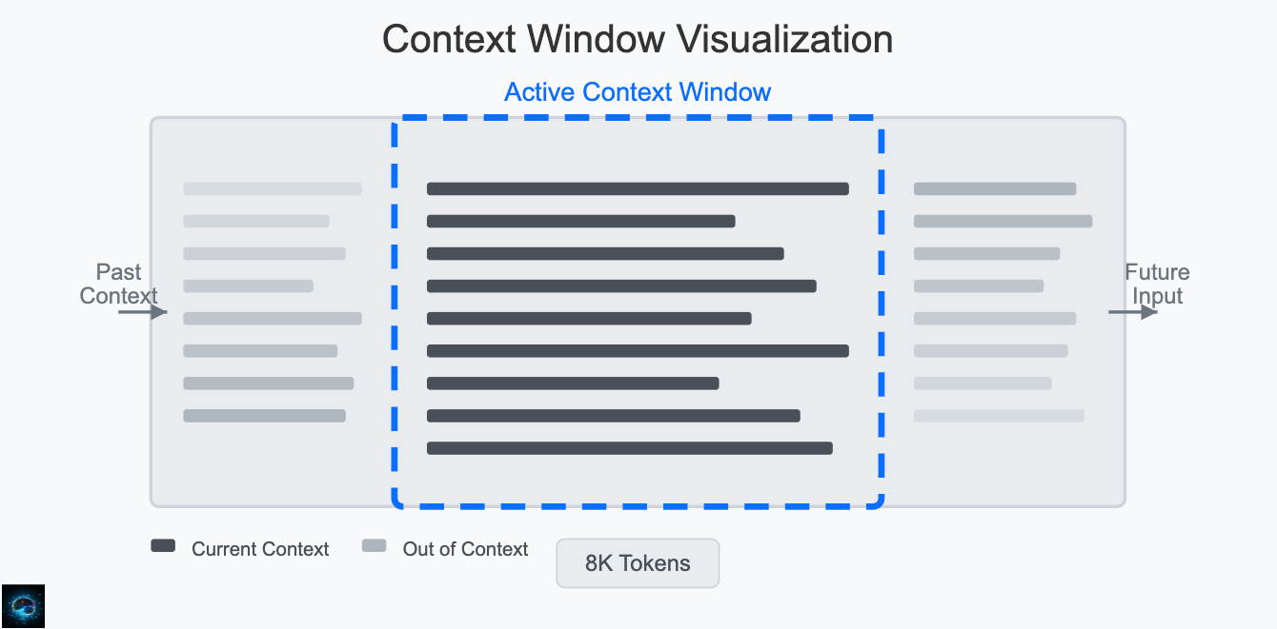


Context Windows
What is a Context Window?
Maximum number of tokens an LLM can process at once
Includes both input prompt and generated output
Determines how much information the model can "remember"
Varies significantly between different models
Evolution of Context Windows
2018: 512 tokens (GPT-1)
2020: 2,048 tokens (GPT-3)
Visualization of how context windows limit the amount of information an LLM can process
2023: 32,000+ tokens (GPT-4, Claude)
2025: 1M+ tokens (Claude Sonnet 4, Gemini 2.5)
Impact on Performance
Longer context = More memory and compute
Models may lose focus on early tokens
Why Context Windows Matter
Performance can degrade at extreme lengths
Larger context windows enable: Processing of longer documents More coherent conversations Better understanding of complex queries Enhanced reasoning capabilities
Trade-off between size and efficiency
Used Context
Example:

Slide 6
Context Window Sizes in Different LLMs
Context windows have dramatically expanded over recent years, enabling LLMs to process increasingly large amounts of information in a single interaction.
Ultra-large (10M+ tokens)
Large (1M+ tokens)
Medium (200K+ tokens)
Standard (128K tokens)
Note: Context window sizes continue to evolve rapidly as technology advances. Some models offer different window sizes based on pricing tiers.

Slide 7

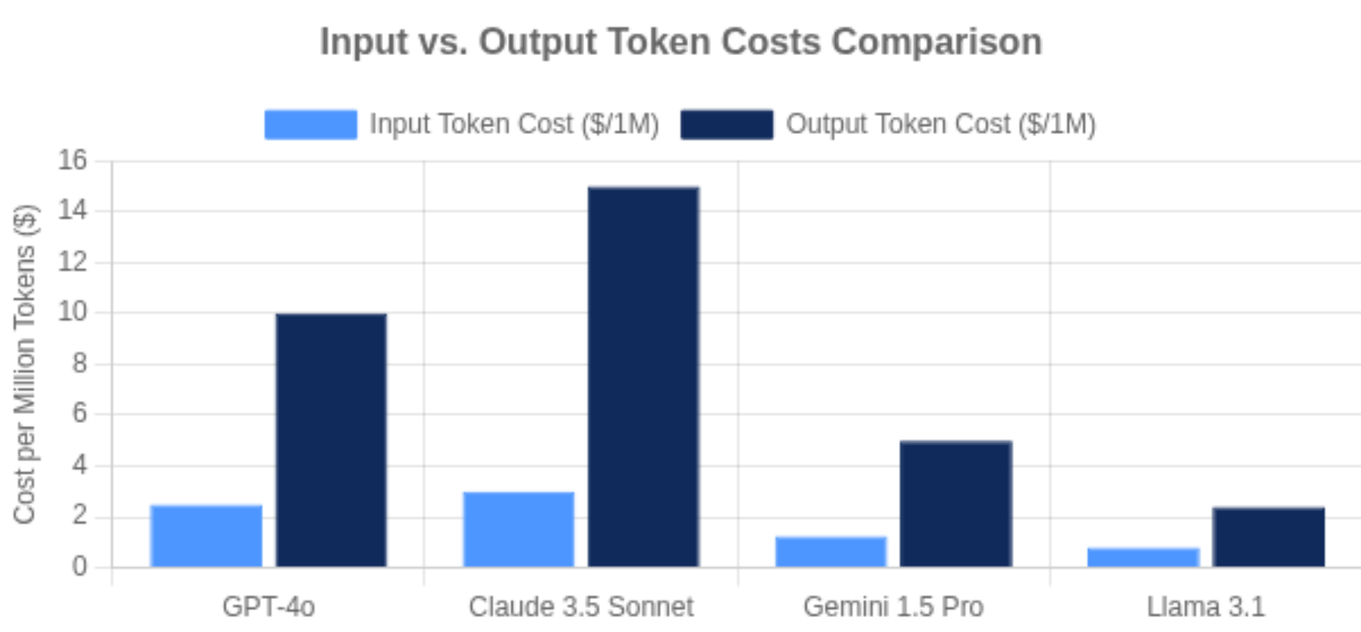


Input and Output Tokens
Input Tokens
Token Count Example
Tokens in your prompt or question
Includes system messages, conversation history
Input: "Explain how LLMs work in simple terms"
~10 input tokens
Generally cheaper than output tokens
Explain
how
LLMs
work
in
simple
terms
Some models offer discounts for cached input
Output: "LLMs process text by breaking it into tokens...
~30 output tokens
LLMs
process
text
by
breaking
...
Output Tokens
Tokens in the model's response
Includes generated text, code, JSON
Typically 2-5x more expensive than input
Limited by model's maximum output setting
Why Token Count Matters
Directly impacts API costs
Affects response time and latency
Determines context window usage
Total Cost = (Input Tokens × Input Price) + (Output Tokens × Output Price)
Key for optimizing applications

Slide 8

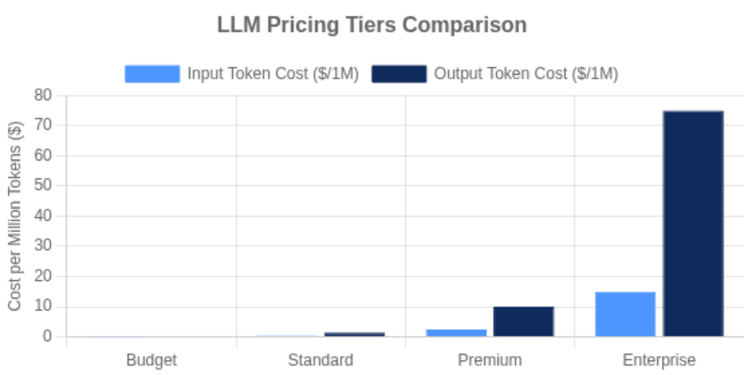


LLM Pricing Models
How LLMs Are Priced
Primarily based on token usage
Input tokens and output tokens priced separately
Higher-tier models cost more per token
Some models offer discounts for cached input
Pricing Factors
Pay-Per-Use Model
Model size - Larger models cost more
Pay only for tokens you use
Performance tier - Premium models cost more
$0.035 - $150 per million tokens
Context window - Larger windows cost more
Specialized capabilities - Vision, coding, etc.
Cost Optimization Strategies
Subscription Model
• Use smaller models for simple tasks
• Implement caching for repeated inputs
Fixed monthly fee with token limits
• Optimize prompt engineering
$20 - $200 per month
• Consider self-hosting for high usage

Slide 9
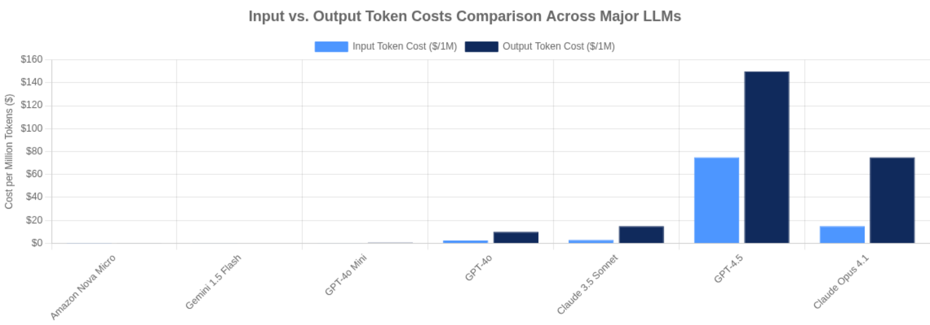









Pricing Comparison
LLM pricing varies significantly across models and providers. Understanding these differences is crucial for cost optimization and selecting the right model for your use case.
Budget Models
Mid-Range Models
Premium Models
Enterprise Models
Amazon Nova Micro, Gemini Flash-8B
GPT-4o Mini, Claude 3.5 Haiku
GPT-4o, Claude 3.5 Sonnet
GPT-4.5, Claude Opus 4.1
$0.15 - $0.60 per 1M tokens
$2.50 - $15 per 1M tokens
$15 - $150 per 1M tokens
$0.04 - $0.15 per 1M tokens
Key Pricing Insights
Output tokens cost 2-10x more than input tokens
Specialized models (coding, vision) often cost more
Some providers offer volume discounts for high usage
Larger context windows typically cost more

Slide 10




Calculating Costs
Cost Optimization Strategies
Step-by-Step Cost Calculation
Use smaller models for simple tasks
1
Count input tokens in your prompt
Limit output length with max tokens parameter
2
Estimate output tokens for expected response
Implement caching for repeated queries
3
Find pricing for your chosen model
Fine-tune models for specific tasks
4
Apply formula to calculate cost
Total Cost = (Input Tokens × Input Price) + (Output Tokens × Output Price)
Advanced Calculations
Monthly Cost: Daily Cost × 30
Per User Cost: Monthly Cost ÷ Users
ROI: (Revenue - Cost) ÷ Cost × 100%
Example Calculation
Scenario: Chatbot using GPT-4o
Input: 1,000 tokens (average conversation)
Output: 500 tokens (average response)
Track token usage in real-time to avoid surprises
Set budget alerts to prevent overspending
Pricing: $2.50/1M input, $10.00/1M output
Cost per conversation = $0.0075
Consider self-hosting for high-volume applications
Use specialized models for specific tasks to reduce costs

Slide 11







Best Practices
Optimize Token Usage
Manage Costs Effectively
• Be concise in prompts
• Monitor usage with analytics
• Limit output length with max tokens
• Implement caching for repeated queries
• Remove redundant context
• Set budget alerts and limits
• Use system messages efficiently
• Consider self-hosting for high volume
Prompt engineering reduces unnecessary tokens
Fine-tune models for specific tasks
Batch requests to reduce API calls
A/B test different models for your use case
Select the Right Model
• Match model capability to task complexity
Key Takeaways
• Use smaller models for simple tasks
Efficiency
Cost-awareness
Right-sizing
• Consider specialized models for specific domains
• Balance performance vs. cost
Monitoring
Iteration

Slide 12







Conclusion
Key Takeaways
Future Trends
Massive Context Windows
Tokens are the fundamental units of AI processing
Context windows determine processing capacity
From thousands to millions of tokens, enabling entire documents in a single prompt
Efficient Architectures
New model designs reducing computational requirements while maintaining performance
Pricing is based on token usage
Balance capability with cost efficiency
Cost Reduction
Continued price drops as technology matures and competition increases
Advanced Reasoning
Models with enhanced chain-of-thought and planning capabilities
Moving Forward
Stay updated on rapid developments
Experiment with different models for your use case
Optimize for cost-effectiveness
Understanding LLM fundamentals is essential for building efficient, cost-effective AI applications
Consider ethical implications of AI deployment

